Slide 1

NEXAM
- An Intelligent Examination Management, Assessment and Proctoring Platform
FINAL REPORT
PROJECT GUIDE :
MS. MOHANA PRIYA
Presenters:
SONIYA
POOJITHA
SHARMILA

Slide 2
INTRODUCTION
NEXAM
Intelligent Examination Management, Assessment & Proctoring Platform
EXISTING SYSTEMS & THEIR GAPS
Google Forms: Online quizzes with limited built-in proctoring.
Moodle: Exam management, with advanced proctoring often requiring plugins.
Dedicated Proctoring Tools: Monitoring features that may operate separately from assessment systems.
WHAT NEXAM COMBINES
Unified Platform: Exams, face verification, monitoring, and MCQ assessment.
Smart Monitoring: Tracks facial presence and browser activity.
Evidence-Based Review: Timestamped violations for faculty verification.
Automated Results: MCQ evaluation and class-wise reports.
OUR DIFFERENCE
One platform. Connected workflows. Fairer examination review.

Slide 3







INTRODUCTION
KEY FEATURES OF EXAM
1. Secure Registration
College email verification and authorized student access.
2. Automated Emails
Examination notifications, reminders, and result emails.
4. Smart Examination Management
Examination scheduling, shuffled questions, and automatic answer saving.
3. AI-Assisted Proctoring
Face verification and suspicious activity monitoring.
5. Automated Assessment
Automatic evaluation of objective questions and coding assessments using test cases.
6. Performance Reports
Student marks, timestamped violation records, and downloadable PDF reports.

Slide 4
LITERATURE REVIEW
S.no | Author-Title | Methodology | Limitations | Our Contribution
1 | Prathish et al. – "Automated Video Proctoring Using ML" (2016) | Motion and audio-based anomaly detection during recorded exam sessions | High false-positive rate in noisy environments; no identity check | NEXAM AI pairs face-verified identity with motion/tab tracking, reducing false flags tied to environment noise
2 | Atoum et al. – "Multimedia Analytics for Online Exam Proctoring" (2017) | Multi-modal analysis: gaze tracking, audio, phone detection | Heavy server-side processing; not feasible in real-time on low-end devices | Runs entirely client-side via face-api.js (TensorFlow.js), needing no server-side ML infrastructure
3 | Hu et al. – "Facial Recognition-Based E-Exam Authentication" (2018) | CNN-based one-time face verification at login | Accuracy drops under poor lighting; verification only at entry, not continuous | Adds continuous re-verification during the exam, not just a single check-in
4 | Bawarith et al. – "E-Exam Cheating Detection System" (2017) | Rule-based behavior tracking (tab switch, timing anomalies) | No identity verification component at all | Combines behavior tracking with face-based I Identity checks for a complete integrity layer
5 | Kaur & Bathla – "Survey on Online Proctoring Techniques" (2020) | Comparative review of commercial proctoring tools | Most tools are paid, closed-source, and require third-party APIs | Fully open, in-browser AI proctoring with zero paid API dependency
6 | Fenu et al. – "Continuous Biometric Verification in E-Learning" (2018) | Periodic biometric re-authentication during online sessions | High computational cost of continuous checks; not tested at scale | Optimized lightweight face descriptor comparison (128-d vector), tuned for browser performance
7 | Asha & Sadasivam – "Cheating Detection in Online Exams Using Image Processing" (2017) | Frame-by-frame image analysis for suspicious activity | No incident logging; alerts not tied to specific submissions | Every violation is logged against the exact student submission for faculty review
8 | Chuang et al. – "Webcam-Based Gaze Tracking for Remote Proctoring" (2019) | Head-pose/gaze estimation to detect looking away | Requires specialized calibration; error-prone across devices | Identified as a planned future upgrade (head-pose detection) built on the existing face landmark pipeline
9 | Opgen-Rhein et al. – "Trust Models for Remote Assessment" (2019) | Framework-level study on trust and academic integrity in e-assessment | Theoretical; no working implementation | Translates the trust framework into a working system with real-time technical enforcement
10 | Singh & Sharma – "Low-Cost AI Solutions for Educational Institutions" (2021) | Review of affordable AI tools for resource-constrained institutions | Found most solutions incomplete or fragmented across separate tools | NEXAM AI unifies identity, proctoring, exam creation, and grading in a single low-cost platform

Slide 5
ABSTRACT
NEXAM is an affordable web-based examination platform combining online tests, identity verification, and continuous proctoring using open web technologies. Student registration is restricted to faculty-uploaded college lists and verified official college emails, preventing fake accounts. Facial recognition verifies students before and during exams. Computer vision detects absent faces, additional persons, mobile phones, and extra monitors, while speech-to-text identifies suspicious vocal activity. NEXAM promotes fair proctoring through tiered flags, warnings, termination, and grace periods to reduce false alarms. Each flag links to a recording timestamp and evidence photo. Risk scores help faculty prioritize reviews, while faculty can confirm or dismiss flags. Students terminated for malpractice are still graded on submitted answers. Features include text, image, and coding questions, automated test-case evaluation, shuffled questions, individual extra time, live monitoring, email notifications, detailed student reports, and roll-number-wise PDF exports. Limitations include privacy and bandwidth concerns, accuracy variations due to lighting and network quality, and the inability of browsers to detect background applications or Bluetooth devices. Large-scale concurrent examinations remain future work.

Slide 6
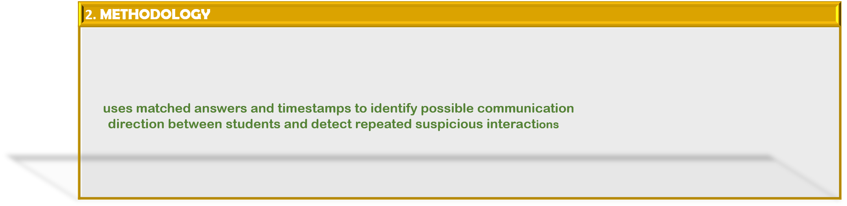
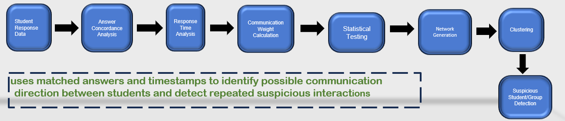
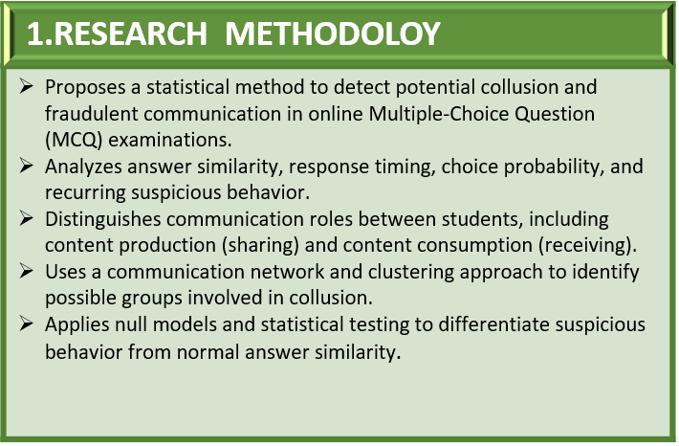
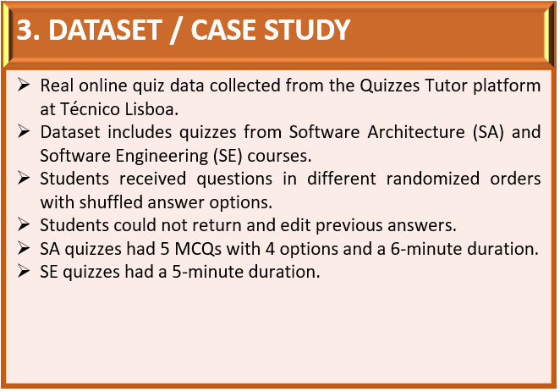
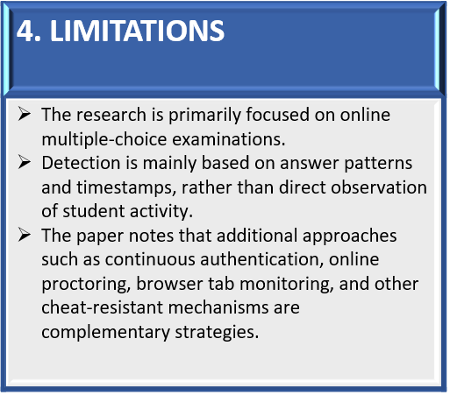
BASE PAPER
BASED ON : IEEE TRANSACTIONS ON COMPUTATIONAL SOCIAL SYSTEMS, VOL. 11, NO. 1, FEBRUARY 2024
Detecting Fraudulent Student Communication in a Multiple Choice Online Test Environment
Mariana Carrasco, António Rito Silva , and Rui Henriques

Slide 7






















System Architecture
User layer
(accessing the system)
Student
Register/login
Take exam
view results
Faculty
Create exam
Monitor live exam
View reports
Admin
Manage user
Manage exam
System setting
Presentation Layer
(web interface)
Login/Registration
(email opt verification)
Student exam page
(MCQ , descriptive , coding)
Faculty dashboard
(live monitoring , reports)
Admin dashboard
(user& exam management)
API Requests/HTTPS
Features in NEXAM:
Answer autosaving
Email notification
User authentication
Objective evaluation
`
Application / backend layer
Automated evaluation
AI- assisted proctoring
Real time faculty monitoring
Answer concordance analysis
  Data organization
Secure registration
Face verification
Student performance reports
Question bank `
Subjective Evaluation
Exam management
AI proctoring layer
Face detection & matching
Multiple face detection
Other device detection
Audio monitoring
Violation handling
Timestamp logs , Auto submission , Report generation
Database Layer
Users
(students , faculty , admin )
Questions
(MCQ , descriptive , coding )
Answer
(submitted , autosave )
Result
(performance )
Violation
(activity , timestamp)
Out put layer
Exam result
Student report
Faculty monitoring
Violation reports
Email notification

Slide 8






CHALLENGES
Challenges in Developing NEXAM
1. Secure Student Authentication
Restrict registration to authorized students through college email verification.
2 . Accurate Face Verification
Confirm that the registered student is attending the examination.
3. Real-Time AI Proctoring
Detect suspicious activities during examinations using webcam monitoring.
4. Violation Management
Apply warning limits, time-based rules, and
automatic exam termination.
!
5. Reliable Examination System
Preserve students' answers during internet I interruptions through automatic saving.
6. Automated Evaluation & Reporting
Evaluate objective and coding questions and .
Generate accurate results and faculty reports.

Slide 9
OBJECTIVE
1. Secure Authentication
- Ensure only authorized students can register and attend examinations.
2. Identity Verification
- Verify student identity using college email OTP and facial recognition
3. Intelligent Proctoring
- Detect suspicious activities and maintain examination integrity.
4. Automated Examination Management
- Simplify exam creation, scheduling, notifications, and submissions.
5. Efficient Evaluation
- Automate objective -question marking and coding assessments using test cases
6. Real-Time Monitoring
- Help faculty monitor examinations and review suspicious incidents.
7. Performance Analysis
- Generate accurate results, detailed student reports, and downloadable PDF documents.

Slide 10
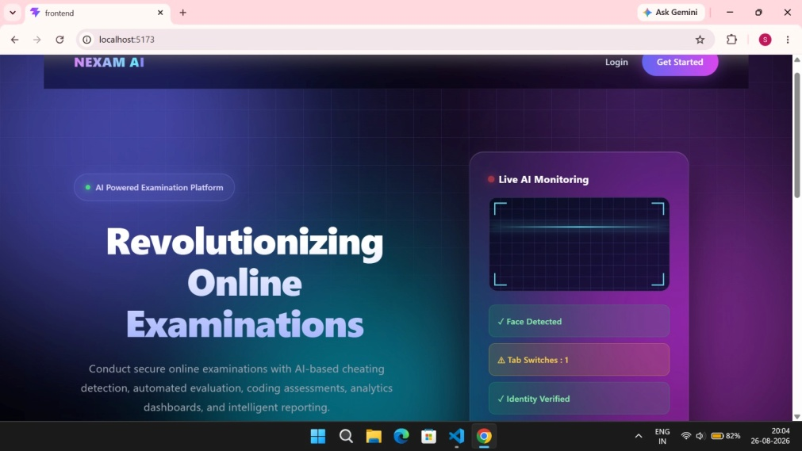
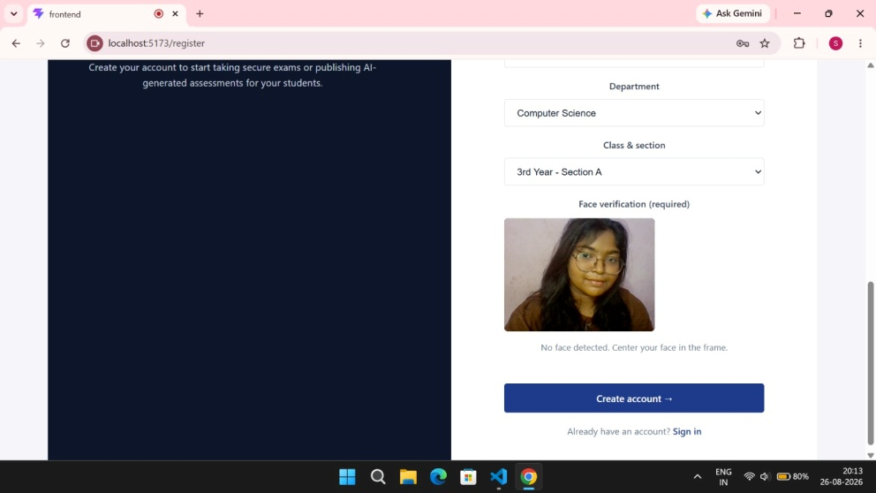
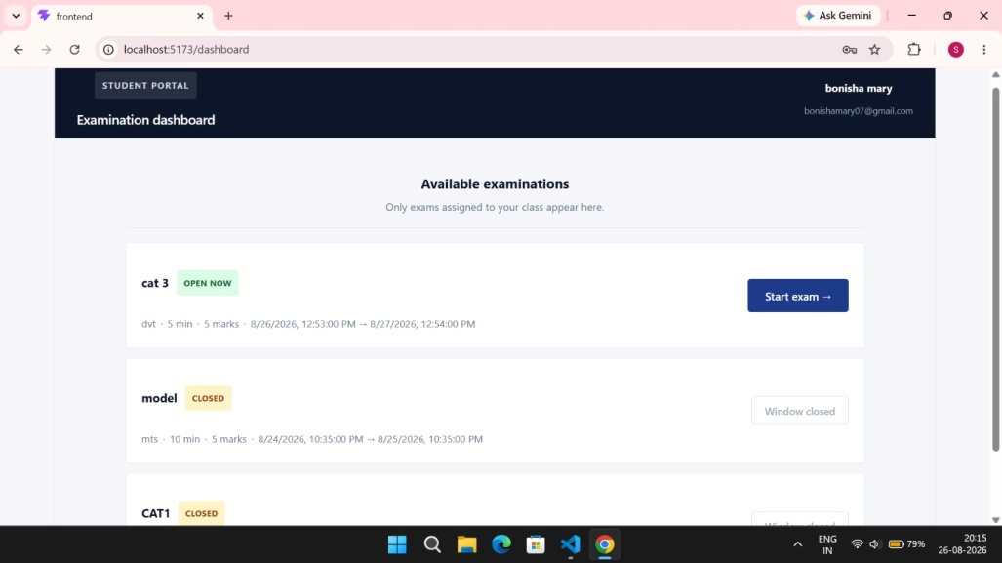
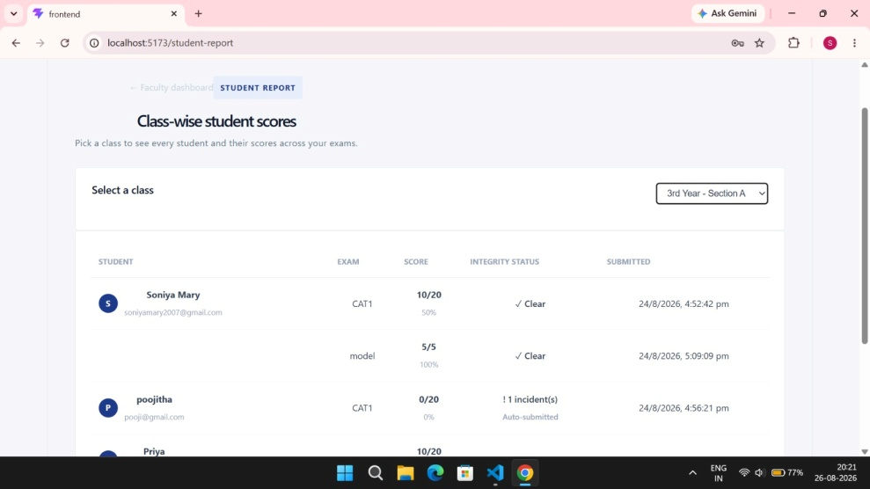
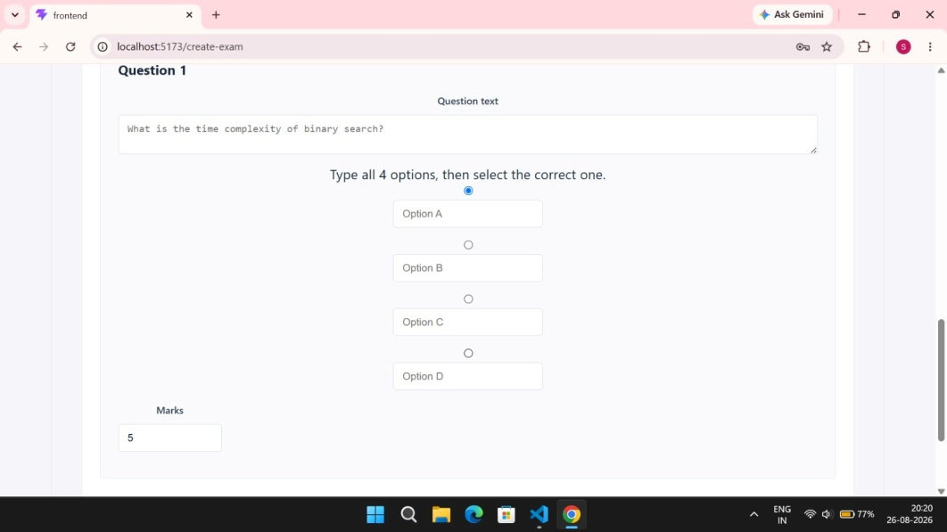
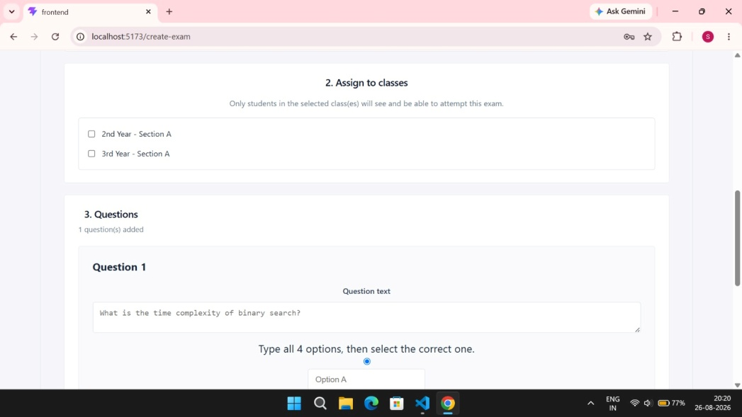
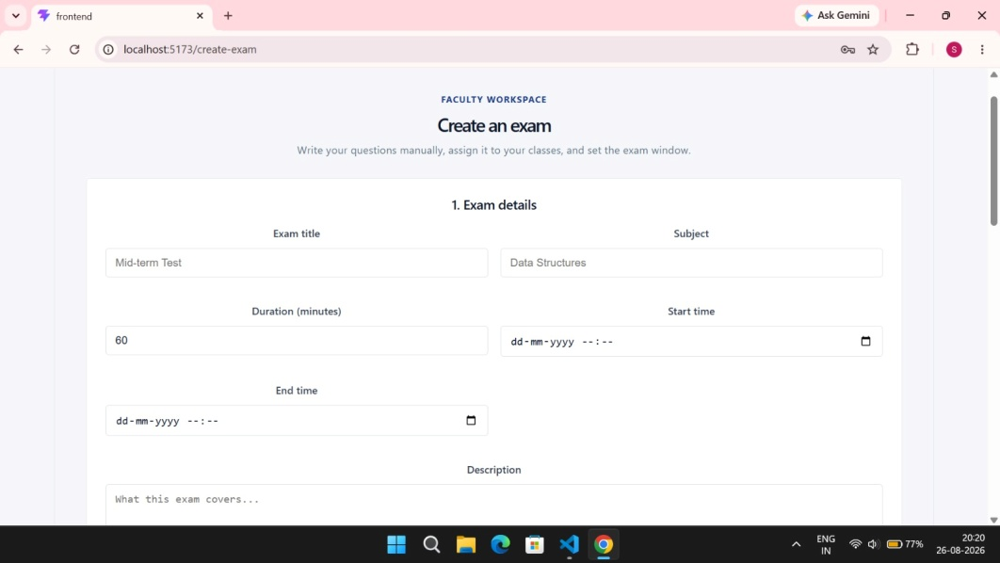
IMPLEMENTATION OF PROPOSED WORK
Landing Page
Face Verification
Student Examination Dashboard
Class Wise Report
Exam Question Management
Assign Classes
Faculty Exam Management

Slide 11
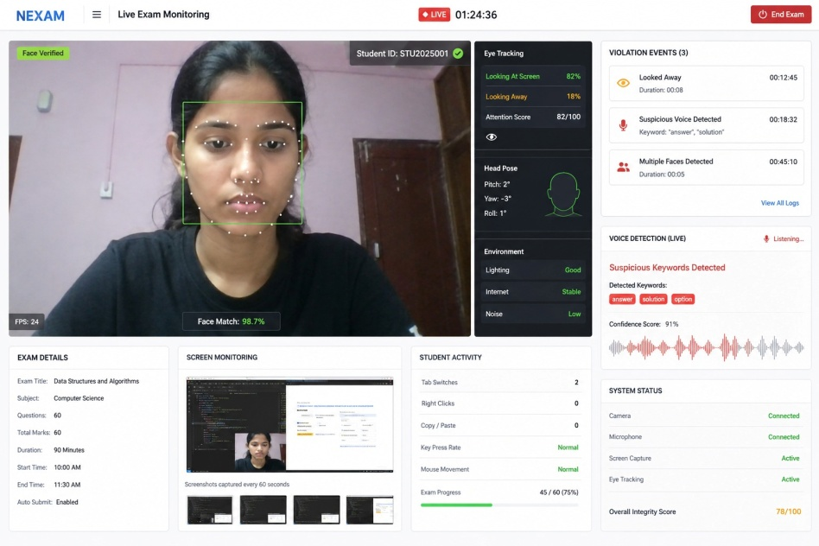
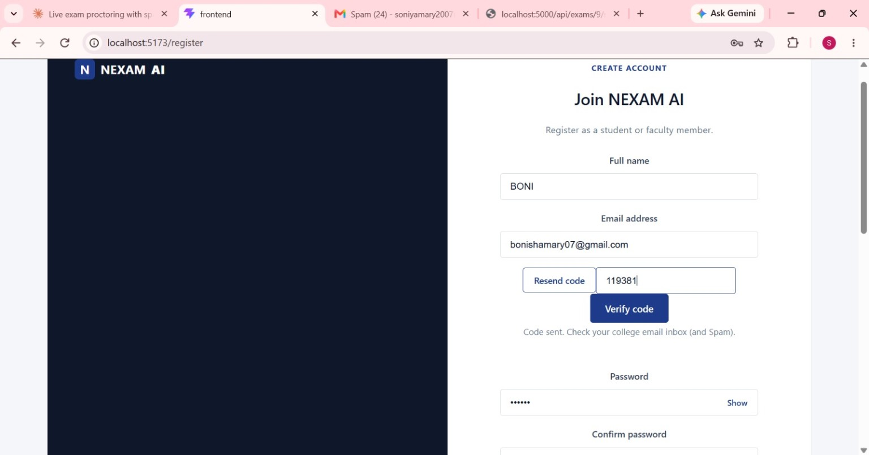
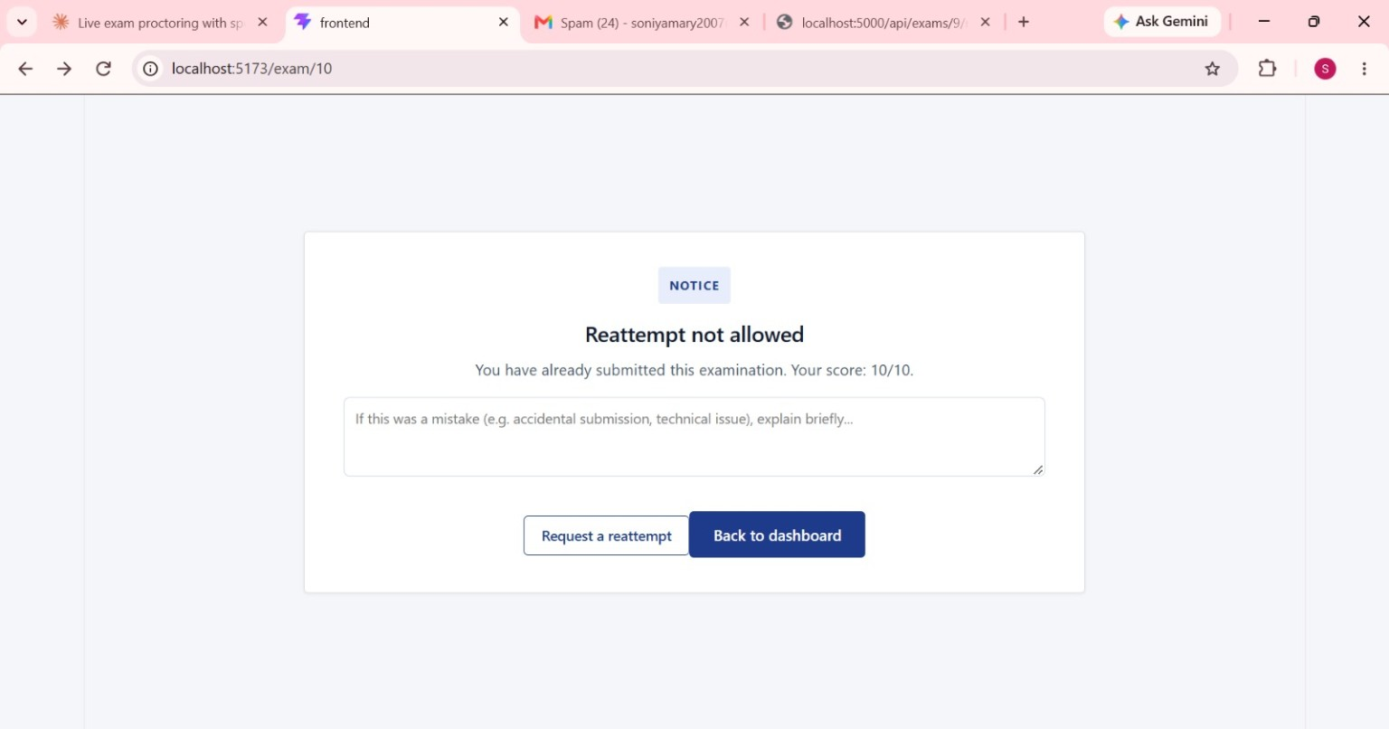
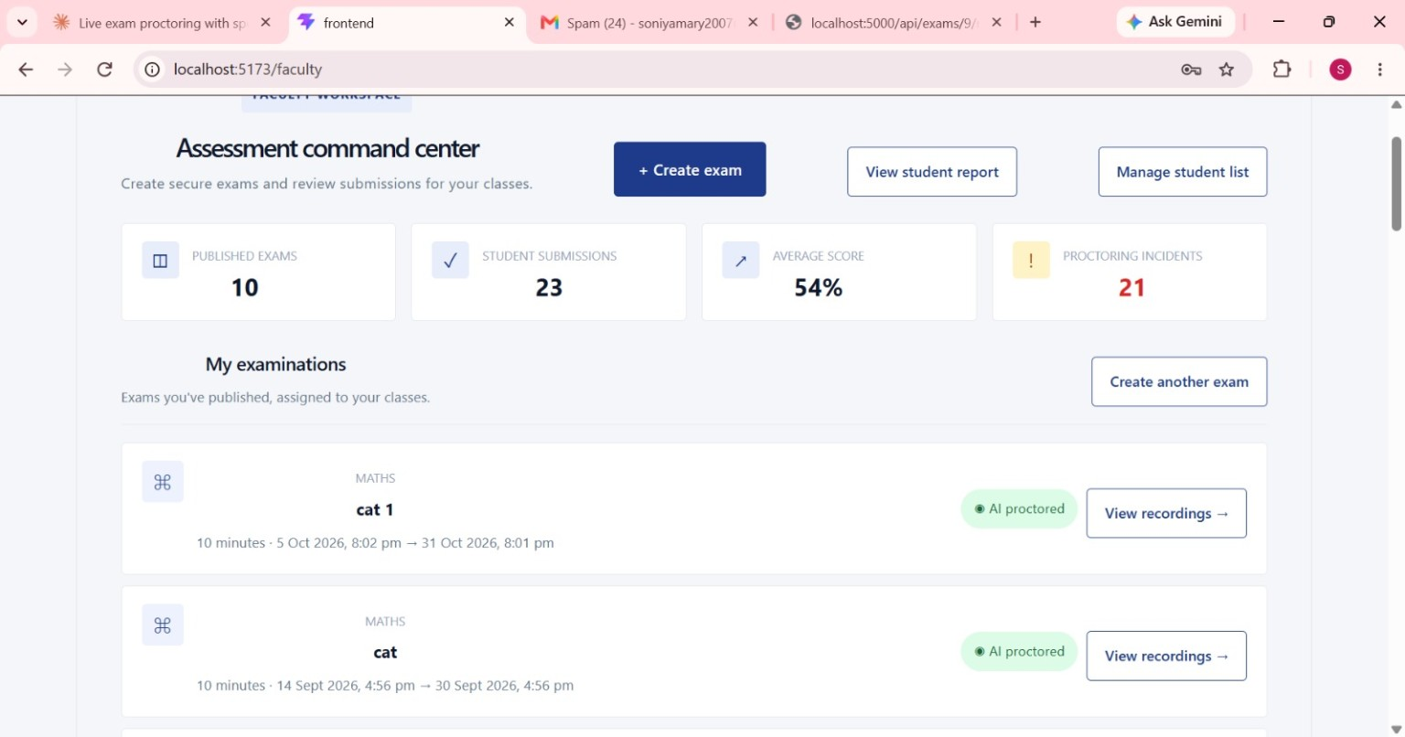
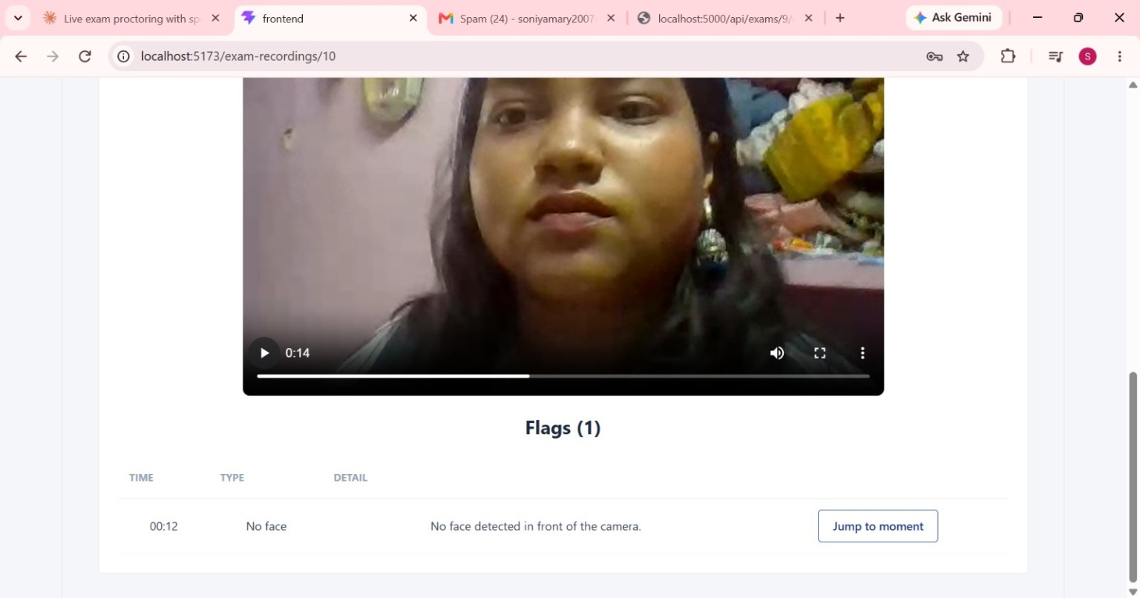
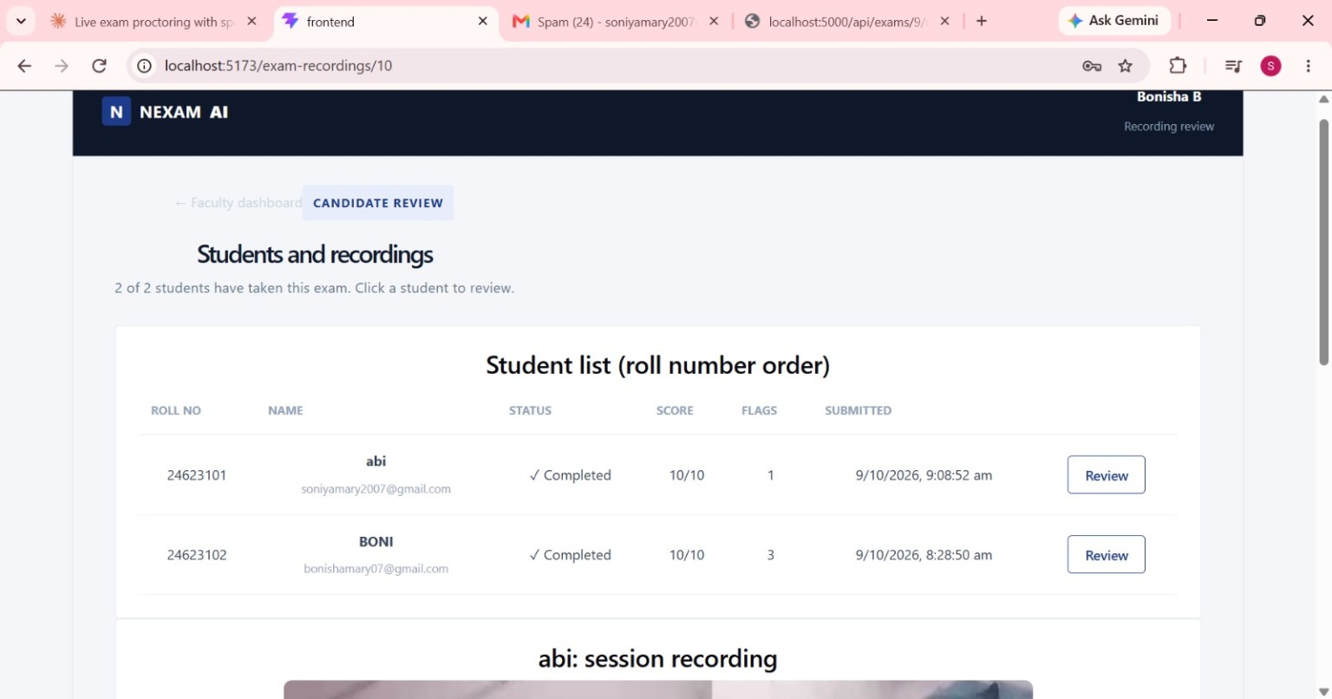
IMPLEMENTATION OF PROPOSED WORK
Live AI Proctored Examination
Student Registration & Email Verification
Reattempt Request
Faculty Dashboard
Recording & Violation Flags
Student Recording Review

Slide 12




RESULTS & IMPACT
Improved Accuracy & Transparency
Face verification and suspicious-activity monitoring. Reduces manual errors with automated evaluation and reliable result management.
Secure Authentication
College email OTP verification and student validation. Reduces unauthorized access and maintains fairness throughout the examination process.
Faster Examination Process
Student results, violation records and PDF reports. streamlines exam creation, scheduling, and result publication through a centralized platform
Efficient Academic Management
Simplifies administration, saves time, and supports data-driven academic decisions.

Slide 13
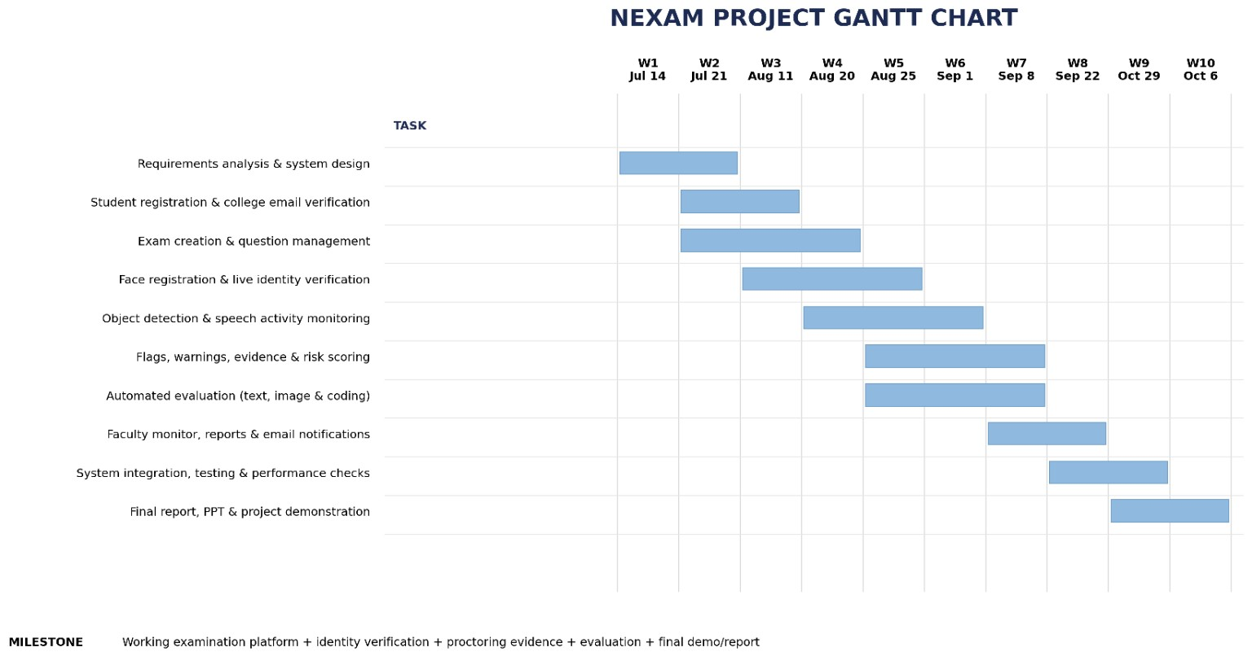
GANTT CHART

Slide 14
THANK YOU

